Slide 1
Crieff High School
Making Choices in the Senior Phase
Session 2020/21

Slide 2
The Options
Pupils will study a range of SQA Courses available at a variety of levels
National Qualifications
Skills for Work courses
National Progression Awards
Higher
Advanced Highers
Crieff High School

Slide 3
How do I choose my subjects?
What are my strengths?
What are my interests?
What do I want to do when I leave school?
What will I need for this?
Crieff High School

Slide 4
Parents and Carers should ask…
Are your aspirations ambitious but realistic?
Are you committed to the work ahead?
Are you sure that you “need” a certain subject for your future?
Crieff High School

Slide 5
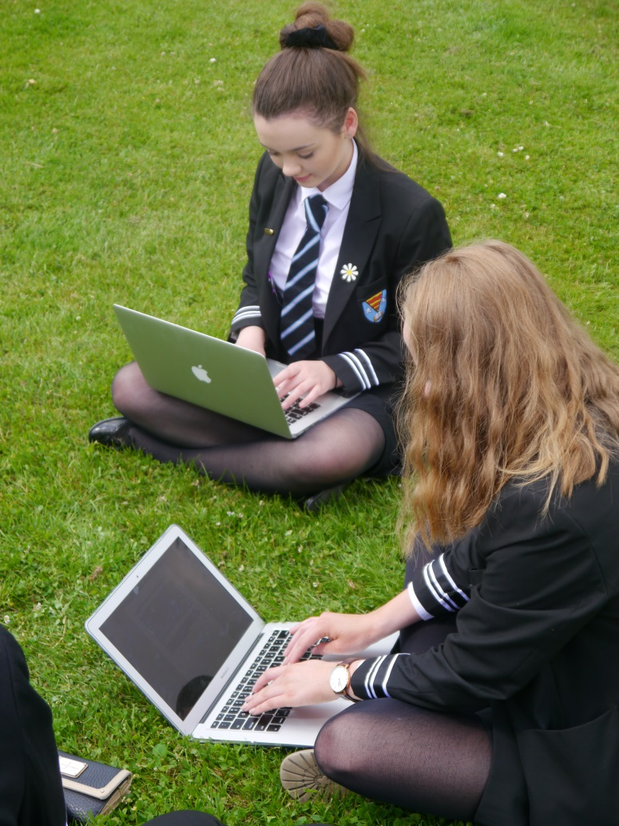
Course Choice Process
Mock Course Choice
SDS Input
Publication of booklet and form
Guidance Interview
Careers’ Fayre
Help/Information
Meet the deadline
Crieff High School

Slide 6
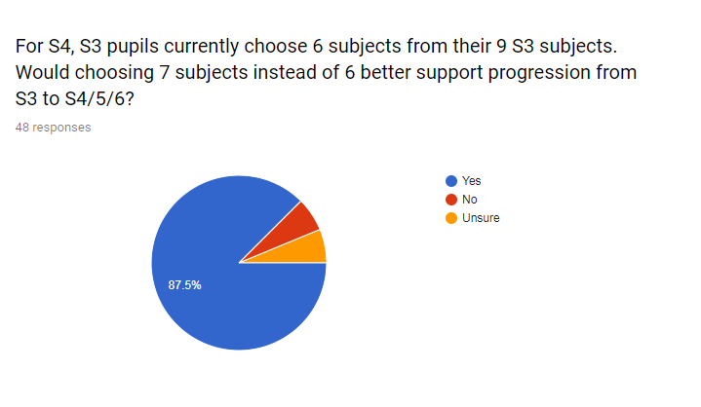
Self evaluation
For S4, S3 pupils currently choose 6 subjects from their 9 S3 subjects. Would choosing 7 subjects instead of 6 better support your progression from S3 → S4/5/6?
Yes 136 | Unsure 41 | No 30
Current S2/S3 pupils

Slide 7
S4 Course Choice
 | Column A | Column B | Column C | Column D | Column E
Subjects Leading to National Qualifications | Biology Chemistry Graphic Communication Modern Studies Physics | Computing Science Geography History Practical Cookery Spanish | Drama French Modern Studies Physical Education Physics Practical Woodwork | Administration & IT Art and Design Biology Design and Manufacture People & Society Religious, Moral and Philosophical Studies (RMPS) | Art and Design Chemistry History Music Physical Education Practical Electronics
Enrichment Options leading to Level 4, 5 and 6 Accreditation | Digital Creativity Laboratory Science | Art & Design Games Development | Retailing Music Performance | PC Passport Sport & Recreation | Mental Health & Wellbeing Travel & Tourism

Slide 8
S5 Course Choice
 | Column A | Column B | Column C | Column D | Column E
Highers | Drama English Graphic Communication Modern Studies | Biology Design and Manufacture English Mathematics Spanish | Art & Design Chemistry French Mathematics Physical Education Religious, Moral and Philosophical Studies (RMPS) | Administraion & IT Biology Computing Science English Geography History Modern Studies Music | Chemistry History Music Physics Sociology
Subjects Leading to National Qualifications | Biology Chemistry English Graphic Communication Modern Studies Physics | Application of Maths Computing Science Geography History Practical Cookery Spanish | Drama French Modern Studies Physical Education Physics Practical Woodwork | Art and Design Biology Design and Manufacture English People & Society Practical Cake Craft Religious, Moral and Philosophical Studies (RMPS) | Art and Design Chemistry History Mathematics Music Physical Education Practical Electronics
Enrichment Options leading to Level 4, 5 and 6 Accreditation | Laboratory Science Digital Creativity | Art & Design Games Development | Retailing Music Performance | PC Passport Sport & Recreation | Mental Health & Wellbeing Travel & Tourism
Wider Achievement | Scottish Studies Web Development | Mental Health & Wellbeing Politics | Food Hygiene Employability | Practical Woodwork Modern Languages Award | Leadership Personal Finance
Pupils wishing to study a two year Foundation Apprenticeship in Business Skills (delivered in school by Perth College) should discuss this with their Guidance Teacher.

Slide 9
S6 Course Choice
 | Column A | Column B | Column C | Column D | Column E
Advanced Highers | Chemistry Drama Graphic Communication History | Design & Manufacture English Mathematics | Art & Design Biology Geography Modern Studies | Music Physics Religious, Moral and Philosophical Studies (RMPS) | Computing Science Physical Education
Highers | Drama English Graphic Communication Modern Studies | Biology Design and Manufacture English Mathematics Spanish | Art & Design Chemistry French Mathematics Physical Education Religious, Moral and Philosophical Studies (RMPS) | Administration & IT Biology Computing Science English Geography History Modern Studies Music | Chemistry History Music Physics Sociology
Subjects Leading to National Qualifications | Biology Chemistry English Graphic Communication Modern Studies Physics | Application of Maths Computing Science Geography History Practical Cookery Spanish | Drama French Modern Studies Physical Education Physics Practical Woodwork | Art and Design Biology Design and Manufacture English People & Society Practical Cake Craft Religious, Moral and Philosophical Studies (RMPS) | Art and Design Chemistry History Mathematics Music Physical Education Practical Electronics
Enrichment Options leading to Level 4, 5 and 6 Accreditation | Laboratory Science Digital Creativity | Art & Design Games Development | Retailing Music Performance | PC Passport Sport & Recreation | Mental Health & Wellbeing Travel & Tourism
Wider Achievement | Scottish Studies Web Development | Mental Health & Wellbeing Politics | Food Hygiene Employability | Practical Woodwork Modern Languages Award | Leadership Personal Finance

Slide 10
The Option Choice Form
The Option Choice Form is set up to maximise the number of pupils who can make their first choices as indicated by the mock course choice and previous subjects studied
Crieff High School

Slide 11
An important point
The availability of any subject in a given column will depend on an adequate number of pupils enrolling for the course and staff availability. No guarantee can be given that every class offered will run. Non-viable classes will be indicated to pupils as soon as possible after the first stage of the course choice process is complete. This will allow an alternative choice to be made.
Crieff High School

Slide 12
Deadline for return of all forms
28th February 2020
Crieff High School

