Slide 1


Supporting Young People with Numeracy
Crieff High School
Mrs Jenni Knak
Confidence Teamwork Determination Encouragement Community Trust

Slide 2
‘The important thing to remember about mathematics is not to be frightened.’
Richard Dawkins
Confidence Teamwork Determination Encouragement Community Trust

Slide 3
Aims (Learning Intentions!)
to feel confident in supporting young people in being positive about numeracy.
to know where to find resources to help when they have questions
Confidence Teamwork Determination Encouragement Community Trust

Slide 4
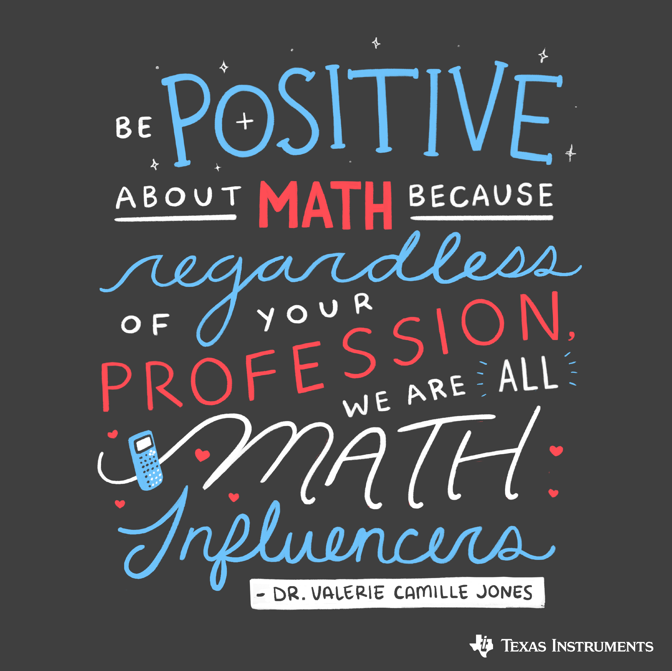
‘Maths is different than it was in my day’
‘I wasn’t good at maths either’
Confidence Teamwork Determination Encouragement Community Trust

Slide 5
Resources to Support Numeracy
*NEW FOR 2025*
CHS Numeracy Support Booklet and Videos
Confidence Teamwork Determination Encouragement Community Trust

Slide 6
Resources to Support Mathematics - BGE
myMaths – Home - MyMaths
Corbett Maths – Videos and Worksheets – Corbettmaths
BBC Bitesize - 3rd level Maths - BBC Bitesize
Confidence Teamwork Determination Encouragement Community Trust

Slide 7
Resources to Support Mathematics – Senior Phase
BBC Bitesize - National 4 Maths - BBC Bitesize
Study Support
Youtube - national 5 maths 2024 – YouTube
Free National 5 Maths Website - Free N5 Maths - Whole Course - National 5 Maths
Confidence Teamwork Determination Encouragement Community Trust

Slide 8
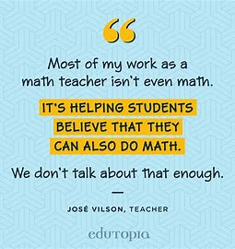
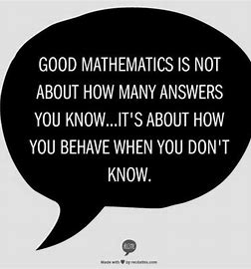
Confidence Teamwork Determination Encouragement Community Trust

